Slide 1
Chapter 6
Econ Spring 2016

Slide 2
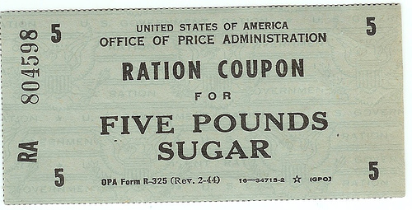
Chapter 6
Price – The monetary value of a product as established by supply and demand
Rationing – A system under which an agency such as government decides everyone’s “fair” share
Ration Coupon – a ticket or a receipt that entitles the holder to obtain a certain amount of a product

Slide 3
Chapter 6
Problems of “Fairness”
Everyone thinks that their fair share is too small
High administrative costs
Diminishing Incentive
Rebate – A partial refund of the original price of the product

Slide 4
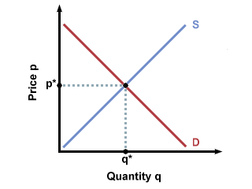
Chapter 6
Economic Model – A set of assumptions that can be listed in a table, illustrated with a graph, or even stated algebraically
Used to help analyze behavior and predict outcomes
Show example (demand/supply schedule & Graph)
Market Equilibrium – A situation in which prices are relatively stable, and the quantity of goods or services supplied is equal to the quantity demanded

Slide 5
Chapter 6
Surplus – A situation in which the quantity supplied is greater than the quantity demanded at a given price
Shortage – A situation in which the quantity demanded is greater than the quantity supplied at a given price
Equilibrium Price – The price that demand meets supply
Show Examples of all three

Slide 6
Warm Up
What is Marginal Cost?
What is Variable Cost?
What are the 7 factors that shift the supply curve?
Graph a surplus
Graph a shortage
What is fixed cost?
What is overhead?
What is the total cost of production?
Name the candidates that are currently running for California Governor

Slide 7
Chapter 6
What happens when the supply AND demand curves move?
Show examples
Price Ceiling – A maximum legal price that can be charged for a product
Show example
Price Floor – The lowest legal price that can be paid for a good or service
Ex) minimum wage
Graph example

Slide 8
Chapter 6
Target Price – A price set with a price floor or ceiling
Nonrecourse Loan – A loan that carries neither a penalty nor further obligation to repay if not paid back
Deficiency Payment – A check sent to producers that makes up the difference between the actual market price and the target price

Slide 9
All Content Created by DJ Cook

